Slide 1
A SAMPLING-FREE APPROXIMATION OF GAUSSIAN VARIATIONAL AUTO-ENCODERS
Gwangwoo Kim
Oct. 6, 2023

Slide 2
Introduction
We want to compute the posterior and marginal distribution in an exact analytical solution without the need for sampling.
Gradient-free learning (Balestriero et al.)
Linear VAE (Lucas et al.)

Slide 3
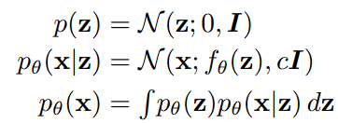
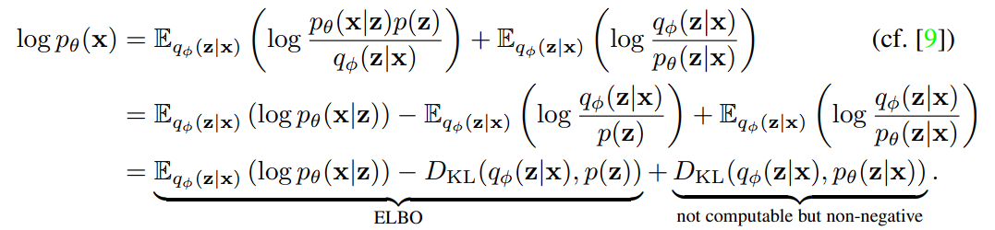
GAUSSIAN VARIATIONAL AUTO-ENCODERS
Setting:

Slide 4

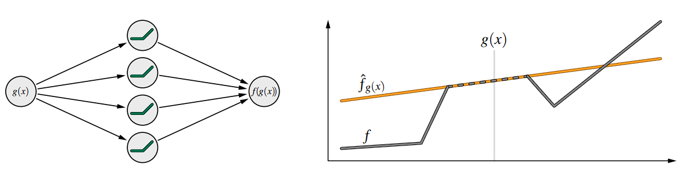
SAMPLING-FREE APPROXIMATION
The Taylor series of the decoder around g(x) is
We can approximate the output distribution as follows:

Slide 5


SAMPLING-FREE APPROXIMATION
As the family of Gaussian distributions is closed under affine transformations and summation
Observation uncertainty:
That is,

Slide 6
Big issues
How to calculate them?

Slide 7
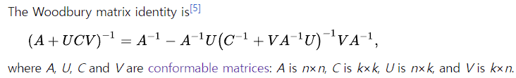
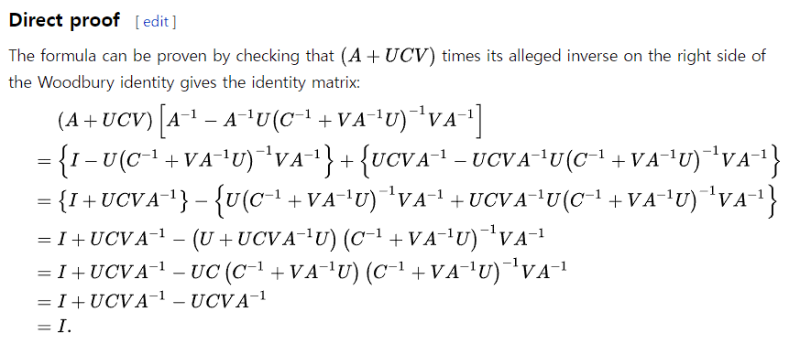
Woodbury matrix identity
Source: https://en.wikipedia.org/wiki/Woodbury_matrix_identity

Slide 8
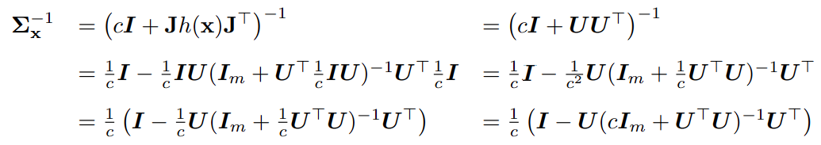
Woodbury matrix identity

Slide 9
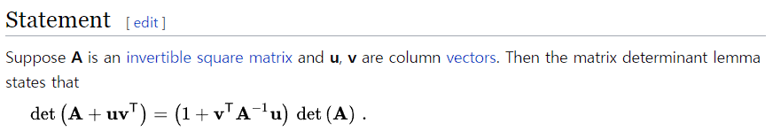
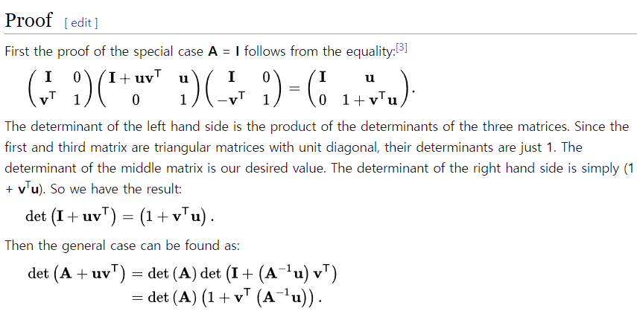
Matrix determinant lemma
Source: https://en.wikipedia.org/wiki/Matrix_determinant_lemma

Slide 10
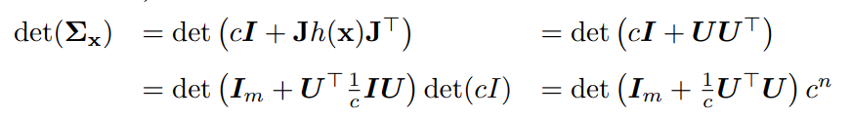
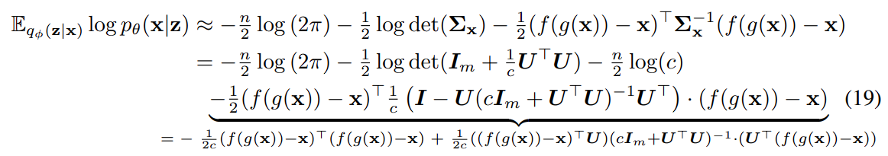
Matrix determinant lemma
Eventually, we obtain

Slide 11


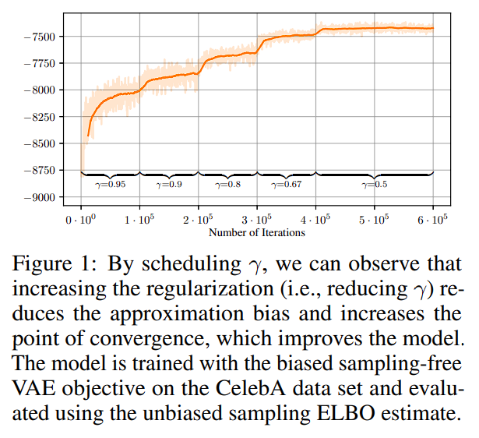
STABILIZING TRAINING AND REDUCING BIAS BY REGULARIZATION
We replace with to stabilize training
That is,

Slide 12
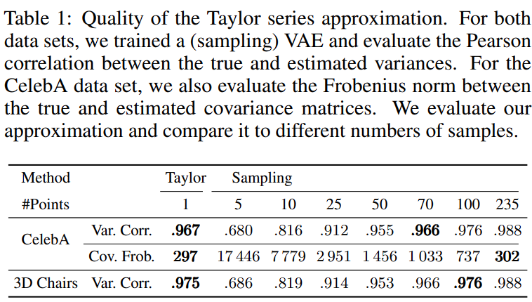
EXPERIMENTS

Slide 13
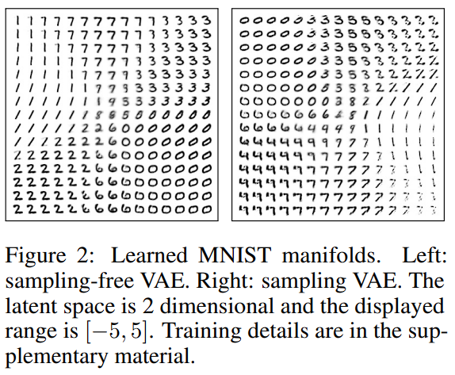
EXPERIMENTS

Slide 14
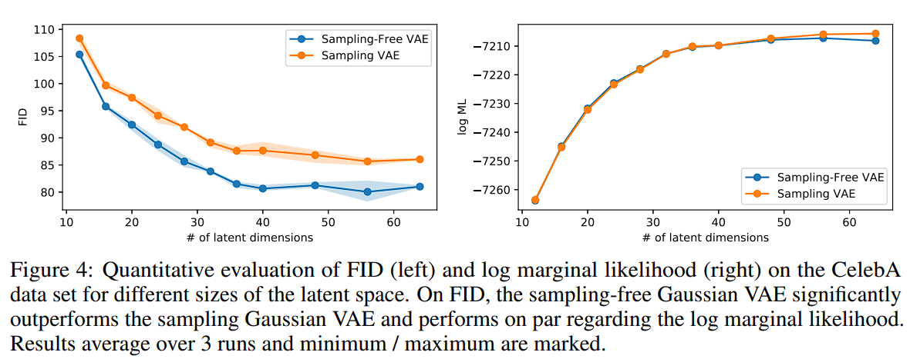
EXPERIMENTS

Slide 15
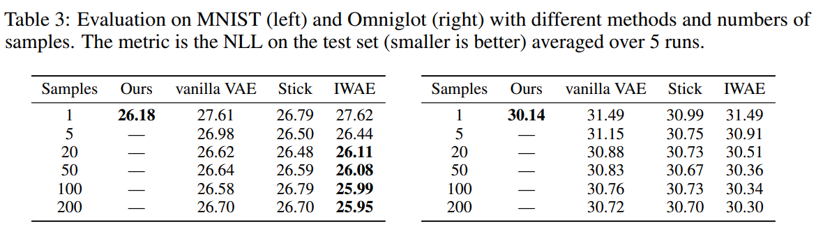
EXPERIMENTS

Slide 16
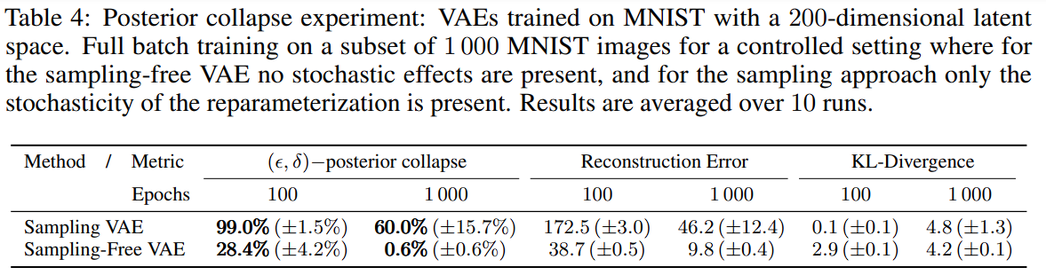
EXPERIMENTS
Lucas et al. introduces the notion of an (e,d)-collapse
A latent dimension j has (e,d)-collapsed if

Slide 17
References
M. A. Woodbury, “Inverting modified matrices,” Memorandum report, vol. 42, no. 106, p. 336, 1950.
D. Harville, “Matrix algebra from a statistician’s perspective springer,” New York, 1997.

Slide 18
Reviewer’s comments

Slide 19
Reviewer SKjV (rating 8)
Weak points:
Limited experiments in terms of considering other baselines
Motivation for the sampling free training is not very well provided considering that it comes with the computational overhead.
Some writing issues.

Slide 20
Reviewer AwHy (rating 5)
Weak points:
The proposed method is similar to the well-known moment matching (MM) methods. However, a discussion of the relationship between the proposed method and MM is missing. In addition, it is better to include a comparison with MM to justify the benefit of the proposed method.
The proposed method is limited to Gaussian VAE.

Slide 21
Reviewer Zwr6 (rating 5)
Weak points:
Posterior collapse part could be more elaborated. Can the authors address more how this approximation could solve the issue?

Slide 22


Reviewer smp3 (rating 5)
Weak points:
The contribution itself is very minor, as Taylor approximations to solve expectations are a common approach in the literature. (e.g., Laplace Approximation or Delta Method)
Wang and Blei (2013)

